Slide 2
Still left behind:
Harm reduction coverage and HIV treatment cascades for people who inject drugs in South Africa
Andrew Scheibe
Share your thoughts on this presentation with #IAS2019

Slide 3
Overview
HIV prevention and treatment services & targets for PWID
South African context
Methods
Coverage and cascades
Conclusions and recommendations
Source: TB HIV Care 2018

Slide 4
Comprehensive HIV services for PWID and targets
Health interventions | Needle/syringe programmes (NSP) Opioid substitution therapy (OST) Anti-retroviral therapy (ART) HIV testing and counselling (HTS) | Target: 300 needles per PWID per year 40% OST coverage Universal access to HTS & ART
 | 4. Prevention and treatment of STIs 5. Condom provision 6. Targeted information, education and communication 7. Prevention, diagnosis treatment and vaccination against viral hepatitin 8. Prevention, diagnosis and treatment of tuberculosis 10. Naloxone and training on overdose prevention for PWID community
Enablers | Supportive legislation and policy Addressing stigma and discrimination Community empowerment Addressing violence against PWID Accessible, available and acceptable services for PWID
WHO 2014

Slide 5
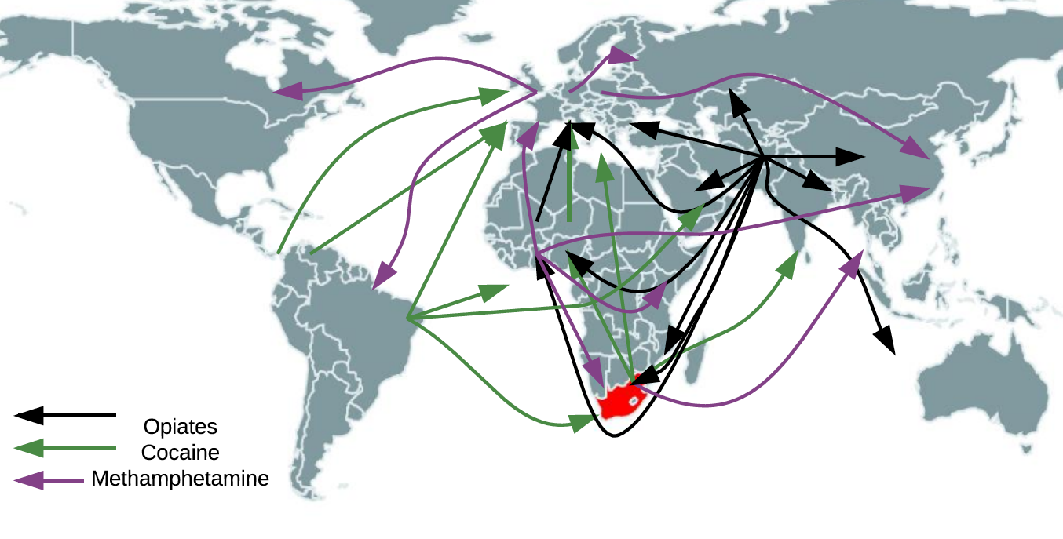
South Africa is part of (injectable) drug trafficking routes
Several routes involving other regions not shown
Adapted from World Drug Report 2015

Slide 6
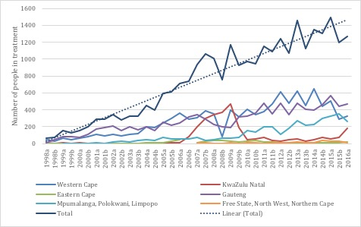
Heroin related admissions, substance use ‘treatment’ sites sites (1998 – 2016)
Heroin use is increasing
Source: Shelly, analysis of SACENDU data 2018

Slide 7
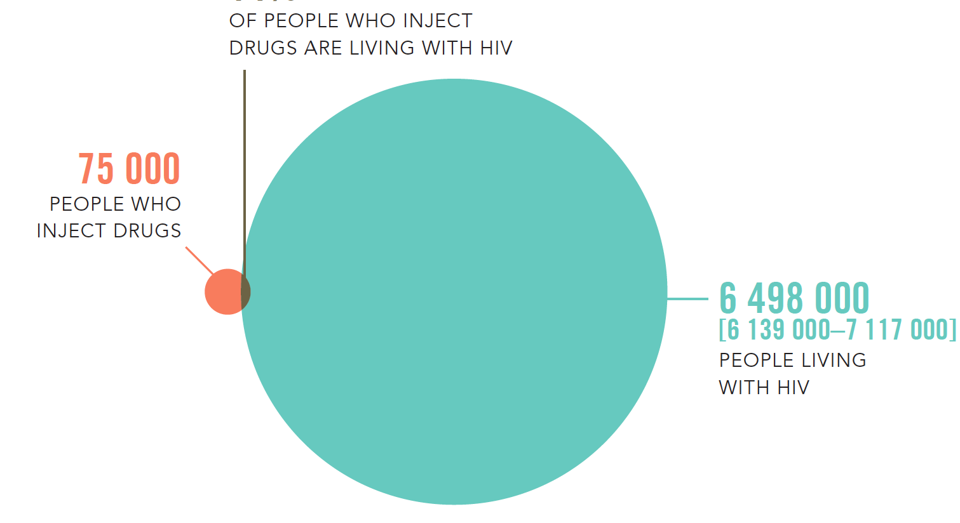
14 - 21 %
Limited epidemiological data
South Africa
HIV epidemiology
Sources: UNAIDS, Do No Harm Report, 2016
﻿Scheibe et al. Harm Reduction Journal (2019) 16:28

Slide 8
Objective
To assess needle distribution, OST coverage and HIV treatment cascades among PWID accessing harm reduction services in five cities
Anova Health Institute 2018
Notes:
Overdose is most important risk – largely due to contaminants, and use of opioids and other sedetives. Uknown concentration – recent empeidic of fentanyl injection.

Slide 9
Methods
Reviewed programme data (Jan – Jun 2018) Assessed:
NSP coverage (no. needles distributed / no. PWID reached)
OST coverage (no. PWID on OST / no. PWID accessing NSP)
HIV treatment cascades

Slide 10
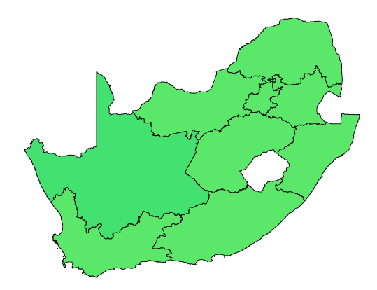
Sites and services (2018)
Pretoria
NSP
OST
HIV testing & treatment
Only city with significant (local) government funding
Johannesburg ⁴
NSP
OST
HIV testing & referral for treatment
Cape Town
NSP
OST
HIV testing & referral for treatment
Port Elizabeth
NSP
HTS
HIV testing & referral
Durban
NSP
OST
HIV testing & referral for treatment

Slide 11
HIV prevention coverage among PWID (Jan – Jun 2018)
Province | WC | KZN | GP |  | EC | Total
City | CT | DBN | JHB | PTA | PE
No. PWID accessed NSP | 700 | 541 | 1 365 | 4 349 | 361 | 7 316
No. needles/syringes distributed | 122 092 | 41 128* | 109 420 | 225 709 | 60 634 | 558 983
Needles/syringes per PWID | 174 | 76 | 80 | 52 | 168 | 76
No. PWID on OST | 55 | 8 | 40 | 157 | 0 | 260
OST coverage | 8% | 1% | 3% | 4% | 0 | 4%
No. PWID testing for HIV | 398 | 170 | 361 | 667 | 177 | 1 773
% PWID testing for HIV | 57% | 31% | 26% | 15% | 49% | 24%
CT: Cape Town; DBN: Durban; EC: Eastern Cape; GP: Gauteng; JHB: Johannesburg; KZN: KwaZulu-Natal; PE: Port Elizabeth; PTA: Pretoria; WC: Western Cape * Durban NSP stopped by municipality in May 2018

Slide 13

Stopping NSP in Durban
”We have to share needles, 2 to 3 people on one needle. When its blunt it hurts your skin” Rashaan, June 2019, TB HIV Care client, Durban
“I’m so scared I’ve got HIV already from using other peoples needles. I don’t know what to do” Mark, June 2019, TB HIV Care client, Durban
Sources: UNODC 2015; Scheibe et al. 2016

Slide 14
Conclusions and recommendations
To reach HIV epidemic control and meet targets among PWID in these cities:
  Needle distribution needs to double
  OST coverage expand ten-fold
  Access to HIV testing and treatment increase five-fold.
  The viral suppression data gaps need to be filled.
Government govt. departments should provide clear, unambiguous support for the WHO package of HIV interventions for PWID
Domestic funding critical for scale-up of HIV prevention services for PWID
Enhanced mechanisms for linkage and monitoring of ART and viral suppression needed
In Durban, stakeholders and others need to influence re-initiation of services

Slide 15







Thank you
Dr. Andrew Scheibe
andrew.scheibe@gmail.com
Matima R, Schneider A, Basson RL, Ngcebetsha S, Padayachee K, von Homeyer Z, Heathfield C, Medeiros N, Manion A, Hugo J, Kroukamp L, Gloeck NR, Bhoora U, Dada S, Young K, Marks M, Shelly S, Harker-Burnhams N, Hausler H.
Partners:

